Slide 1
Freshman RPG Iteration #4
Companion App

Slide 2
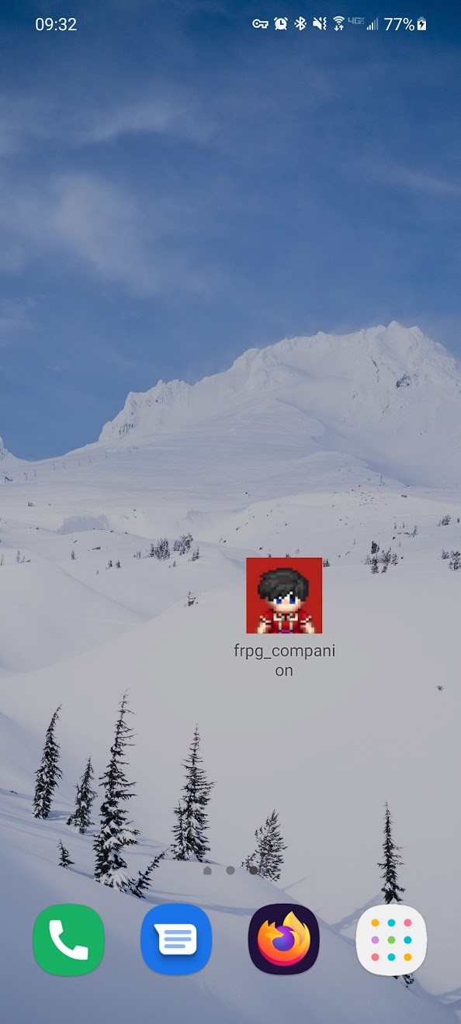
Story 1: App Icon
Simple app icon was added

Slide 3
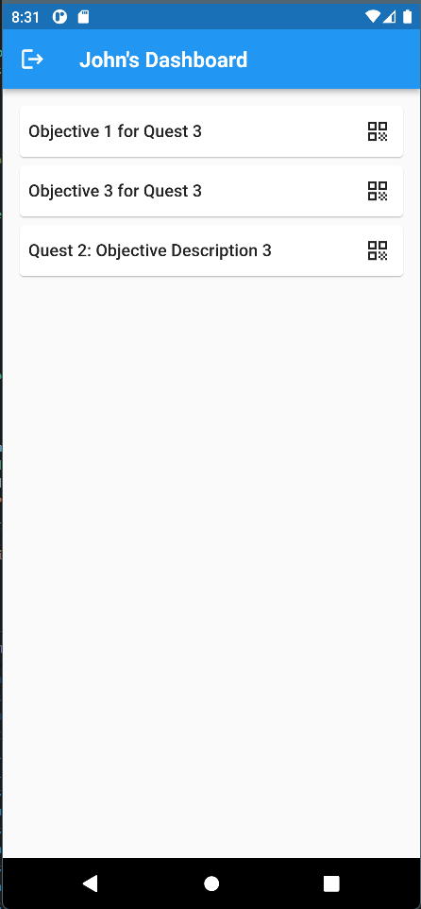
Story 2: Quest Log
Shows a list of all currently open objectives
QR code button opens scanner to complete objective

Slide 4
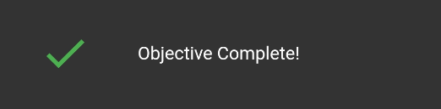
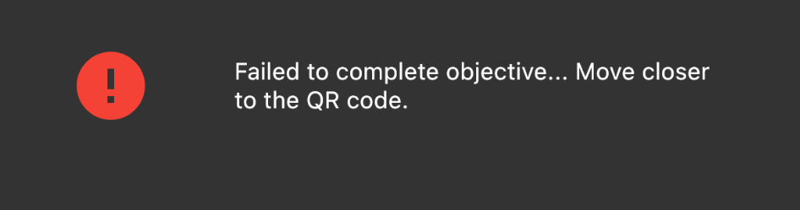
Story 3: Geo Location Verification
Requires you to be at object location
Prevents cheating

Slide 5
What We Can Do in the Future
Loading Icons for when waiting to log in / complete objectives
Alternate types of external objectives (quiz / survey)
In-App character customization / management
Could include merch shop

Slide 6
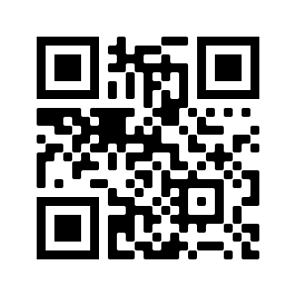
Time for a demo
Quest 2: Objective 3 Location Jun’s Bedroom

Slide 7
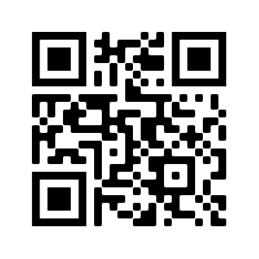
Time for a demo
Quest 3: Objective 3 Location MCT 162

Slide 8
Any Questions?

